Slide 1
Semester project presentation
1. Introduction
Extending Dynamic Structure in Memory Network for Response Generation
Supervisor: Mi Fei
Director: Prof .Boi Faltings
Myself: André Cibils
Plan:
1. Introduction
2. Encoder-Decoder modification
3. Pointer Network modification
4. Conclusion
5. Questions
Extending Dynamic Structure in Memory Network for Response Generation
Notes:
Goal of the project
Modify and extend the memory structure of dynamic memory network to produce multiple word answer
Annonce du plan

Slide 2
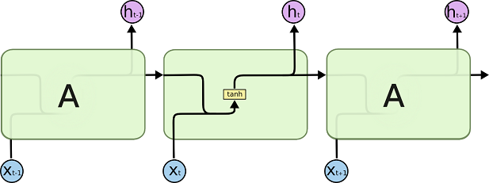
Dynamic Memory Network [1]
1. Introduction
4 parts:
  Input module
  Question module
  Episodic memory module
  Answer module
Neural network based framework
Internal memory representation (memory vector m)
Uses lot of Gated Recurrent Units
End-to-end
Notes:
Quick explanation
Input module encode the input by using word embedding and GRU: #Tc facts representation, one for each sentence, or if only one sentence, one fact repr for each word
Question module encode the queston using the same mechanism that the input m. Only one q representation
Episodic module iterates over the fact repr and update the mem vec
Answer module decodes the final mem vec

Slide 3
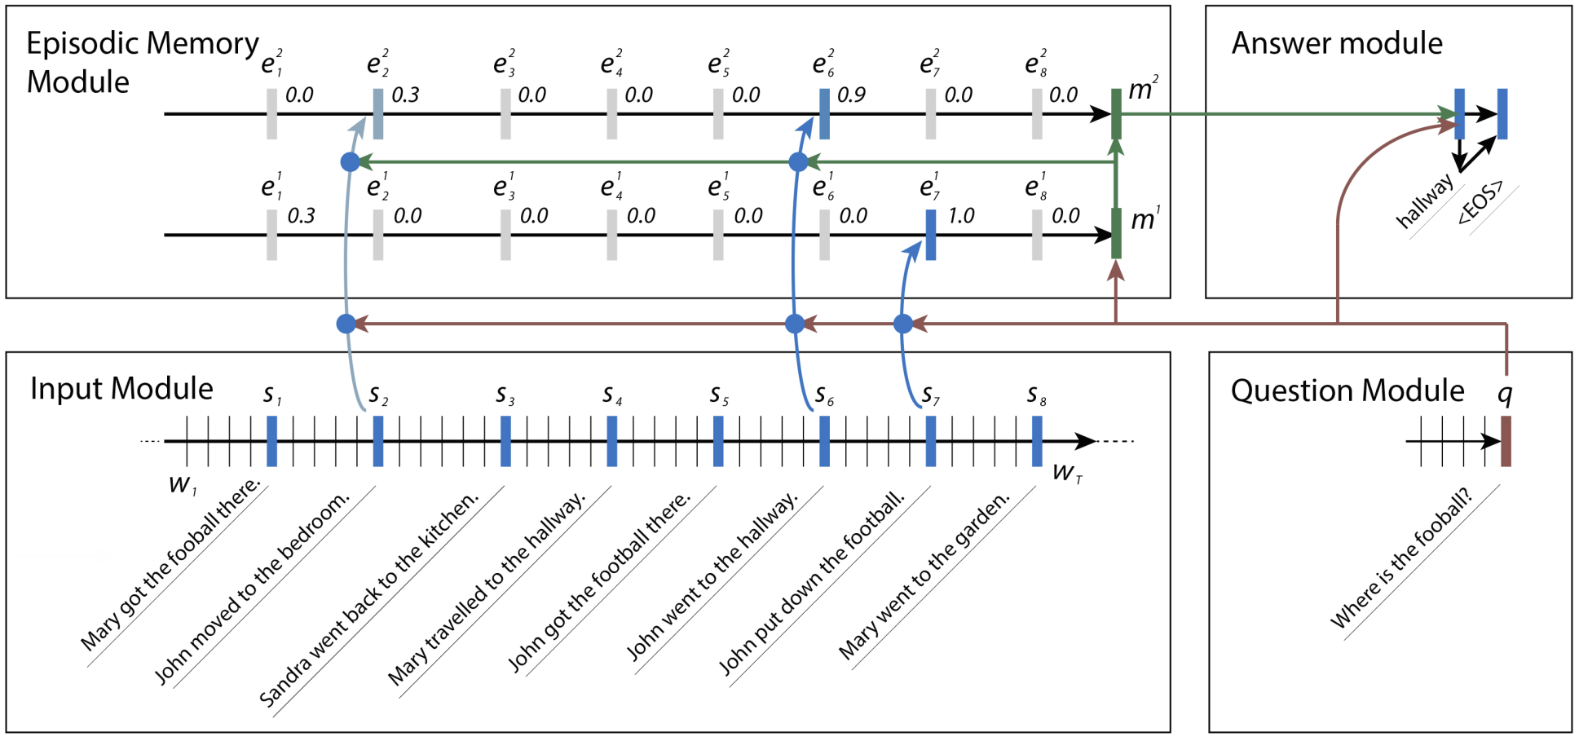
Dynamic Memory Network
1. Introduction
Notes:
Present the different part to prepare for the next 3 slides

Slide 4



Dynamic Memory Network
1. Introduction
Notes:
Explain what is L[W], similarity between input/quest module
-fact repre
-question repre

Slide 5

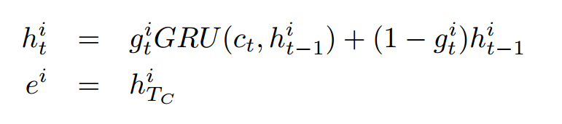
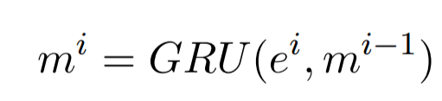
Dynamic Memory Network
1. Introduction
Notes:
Episodic memory module, explain
-what is the mem update mecha
-what is the att mecha

Slide 6

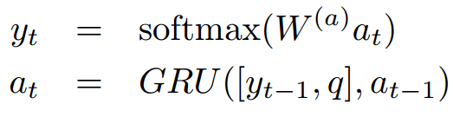
Dynamic Memory Network
1. Introduction
Notes:
Soulign the fact that the q is used in the answer mod
Iteration is not mandatory

Slide 7
Implementation details
1. Introduction
Supervised classification problem
Model is end-to-end!
Trained via back propagation through time and gradient descent
Use L2 regularisation
Notes:
Explain end to end
Explain classification

Slide 8
Goal?
1. Introduction
Given a text and a question as input, generate a sentence as an answer
  This require the ability to retrieve facts and reason over them, but also to be able to generate a sentence
General idea to solve this problem:
  Use DMN as it showed multiple skills like deduction or coreference resolution
  Combine it with a sentence generative model
Notes:
Why is it important? Link with chatbox
Give number about how well perfoms DMN ~90% acc on almost all bAbi tasks

Slide 9
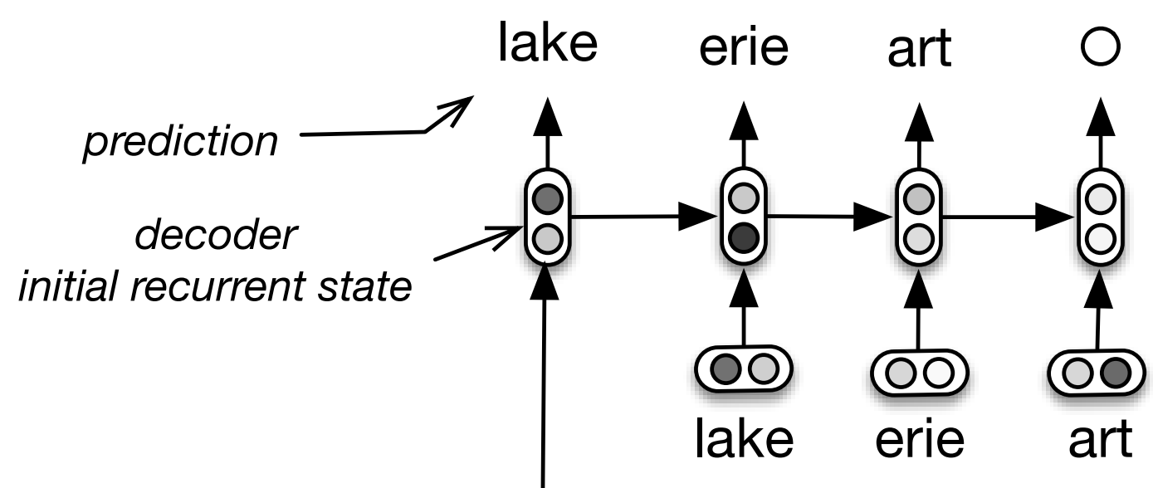
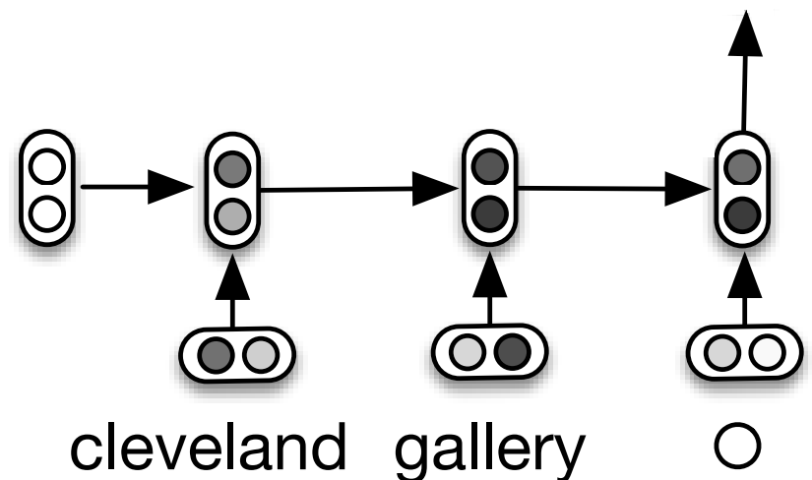
First modification:
Encoder-Decoder [2]
2. Encoder-Decoder modification
Use DMN for all the reasoning part
Use the Encoder-Decoder architecture to generate sentences
Idea: see the answer module as a decoder
It can now produce a fixed & limited number of words.
Notes:
What is encoder-decoder:
Encoder Decoder arch is used in auto-completion task, query reformulation. One RNN encode the previous query (context-aware and order-sensitive), one RNN decode it to generate new words
Why is it okay to use it here?
We consider the mem vec as the encoding needed for the decoder, so the answer module is now a decoder

Slide 10
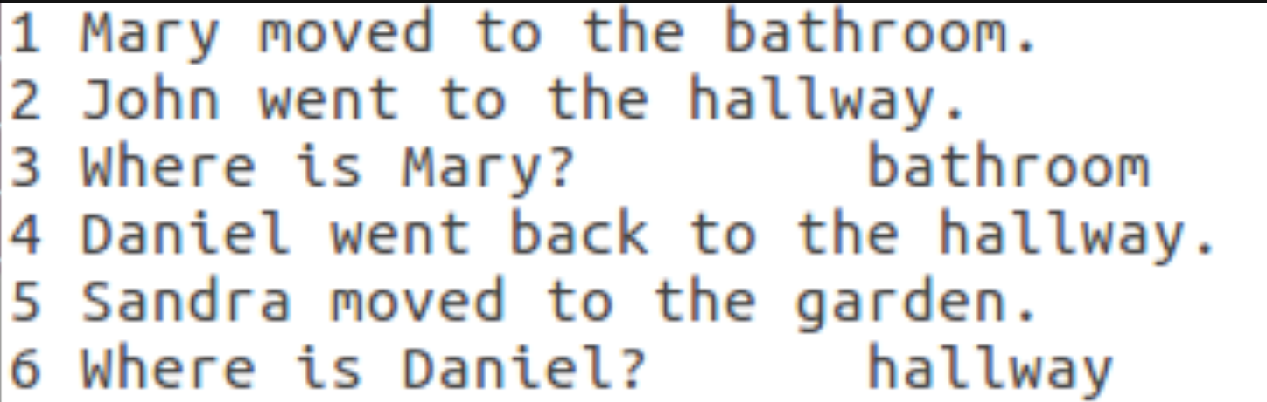
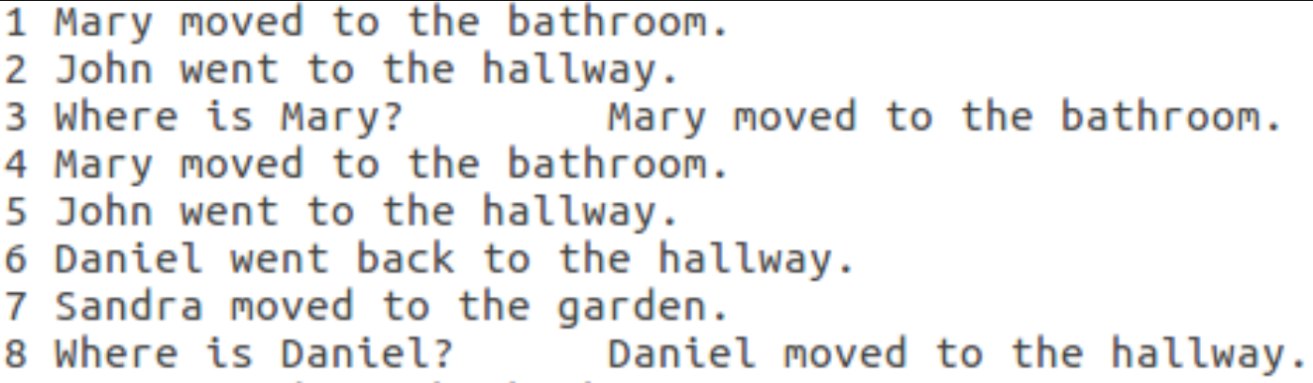
Implementation details
2. Encoder-Decoder modification
Modification of the bAbi data set
Simple sentences as answers
Use GloVe to have word embeddings
Answers always have the same architecture
<Subject> moved to the <Place>. (ex: "Marie moved to the office.")
Notes:
Loss calculation is obviously modified as well
We can learn the model to produce <eos> char, so having a fixed nbr of words is not a problem
Why so simple sentence?
"Use GloVe": what is GloVe?

Slide 11
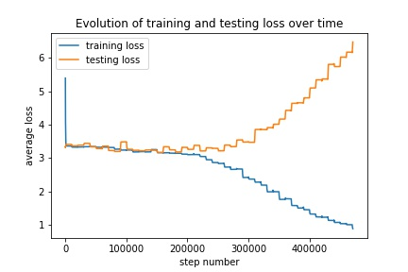
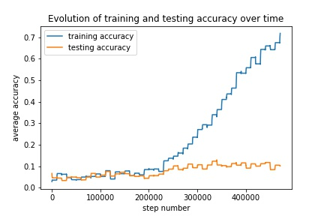
Only 1000 exemples
Over-fitting
Accuracy: either 1 if the model predicted the right sentence or 0!
Notes:
Explain the graphs & the correlation between the two: low accuracy & low loss => model got the easy part but fails to get the Subject & the Place
Loss go down quickly!
Give exemple for accuracy
EXPLAIN THE GRAPHS: YES, it's written, no, they won't read!

Slide 12
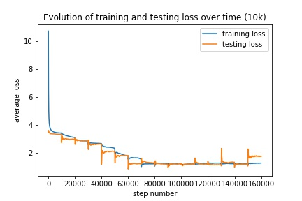
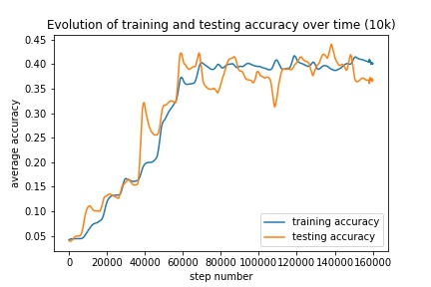
Notes:
Why & how are the new graphs better than the old one?
-> prove that the idea is good!
EXPLAIN THE GRAPHS if you haven't
Compare with DMN: 40% acc is better, but it sucks

Slide 13
First version of the Encoder-Decoder: analyse of the results
2. Encoder-Decoder modification
High tendencie to overfit
However, with a lot of data, seems to work
Models focus on learning the easy part of the sentence: reasonning ability is compromised
<Subject> went to the <Place>. (ex: "Marie went to the office.")
Notes:
Explain why it fails
-> lot of information is loss during the decoding
Recall what loss going down and accuracy being capped means
-> loss calculation is equivalent for each word, but it's logical (why force the model to learn specific parts?)

Slide 14
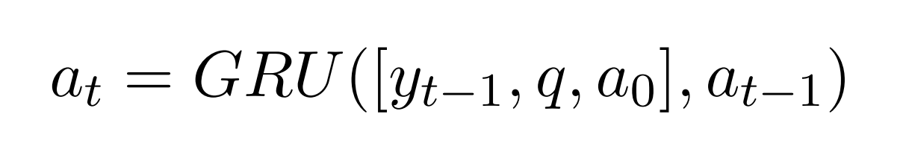
Encoder-Decoder – Why does it fail?
2. Encoder-Decoder modification
The GRU decoder is hard to train.
  Idea: make it easier for the model
Small modification of the answer module: Add the original memory vector as input
Notes:
Lot of info loss as the decoder updates its internal memory: GRU decoder are hard to train
Idea is to simplify its task by giving it the original mem vec at each ite
Hypothesis: If GRU decoder are hard to train & there is loss information, then if we make it less dificult, it should perform better.

Slide 15
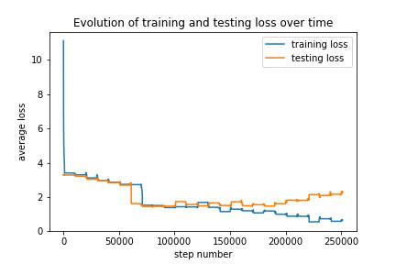
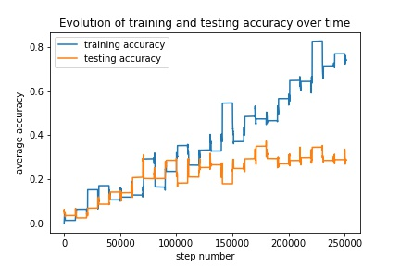
2. Encoder-Decoder modification
Only 1000 exemples
Over-fitting, again
Notes:
EXPLAIN THE GRAPHS AGAIN
Notice overfitting, don't go on the 25% road now

Slide 16
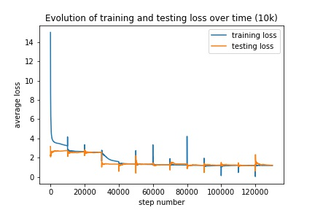
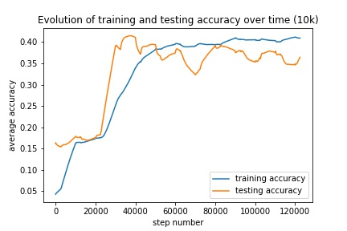
Notes:
EXPLAIN THE GRAPHS
Prepare for the next slide, tell the results (25%, 40% acc)

Slide 17
Evolution of accuracy on a small dataset
2. Encoder-Decoder modification
With the memory vector as input
  Testing accuracy goes up to ~25%
First modification
  Testing accuracy is caped at ~10%
Notes:
Confirm hypothesis: it's hard to train
Notice that overfitting occurs earlier: meaning it is indeed easier
However, tell that it's still far from perfect. The road seems interesting, but blabla not enough data & not working as we wished it did.
Wrap up, conclude, we're moving to pointer net

Slide 18
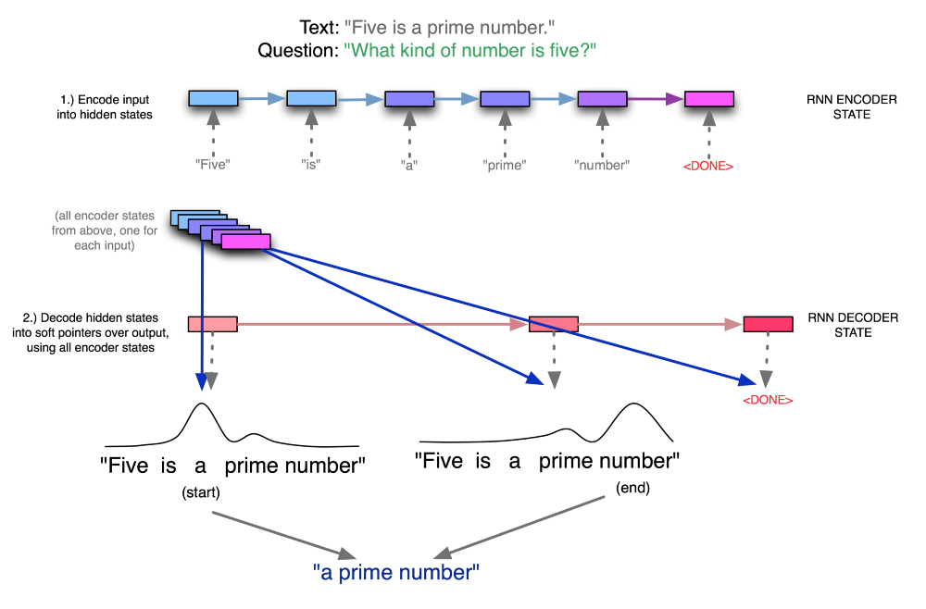
Pointer Nets - Quickly
3. Pointer Network modification
Notes:
Explain Quickly what is a pointer net:
-must produce output seq whose token must come from the input
-attention mechanism
Sort of similar to DMN but not really

Slide 19
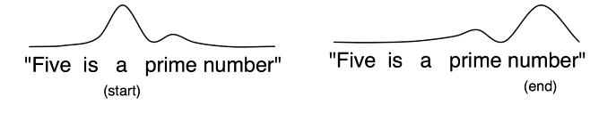
Pointer network modification [3]
3. Pointer Network modification
GRU Decoder is hard to train, but pointer networks should be easy.
Hypothesis: the answer is in the text
The goal is to find where it is, i.e. Produce a start and end idx
Notes:
Explain why it makes sense:
The Enc-Dec looks not so promising due to trainability being hard, so why not use a simplest model?
Different hypothesis: justify it. Explain that if it works, we can build around it.

Slide 20
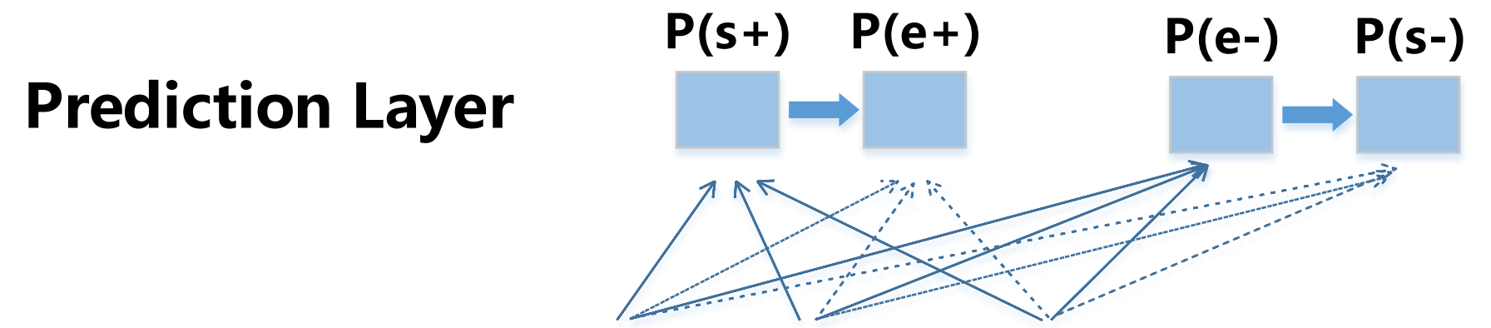
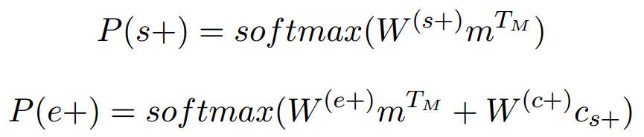
Implementation details
3. Pointer Network modification
SQuAD data set – complex and diverse
  Multiple topics from wikipedia
  Every answer to each question is a segment of text
Two-directional prediction: produce start idx, then use it to produce end idx & redo it the other way, then merge
Notes:
Explain SQuAD data set. What is SQuAD? Why SquAD? Why does it make sense?
Two-directional? Why? Gives better results
How de we merge? Why? Mean merge, gives better results
Explain the equations

Slide 21
Conclusion
4. Conclusion
Goal: Modify DMN to produce multiple word answer
  Need multiple abilities: fact retrieving and resoning, but also sentence generation
Encoder-Decoder Architecture
  Promising results, but decoder LSTM are too hard to train
Pointer Network Architecture
  Need more refining
Other Architectures? Merge of the previous ones?
Notes:
DMN for the reasonning, something else for sentence gen

Slide 22
Referencs
4. Conclusion
[1] Ask Me Anything: Dynamic Memory Network for Question Answering, 5 Mar 2016
[2] A Hierarchical Recurrent Encoder-Decoder for Generative Context-Aware Query Suggestion, 8 Jul 2015
[3] Exploring Question Understanding and Adaptation in Neural-Network-Based Question Answering, 25 Mar 2017

Slide 23
Questions?
5. Questions

